Slide 1
ANTI-DIARRHOEAL AGENTS PHA 304 Lecture
BY
Pharm F.A OLADOJA.
B.Pharm, M.Sc., ACISM(USA), ACIWM, PGD, ACA
Department of Pharmacology and Toxicology,
Faculty of Pharmacy,
Olabisi Onabanjo University.

Slide 2
DIARRHOEA
Diarrhoea is too frequent, often too precipitate passage of poorly formed stools.
It is defined by WHO as 3 or more loose or watery stools in a 24 hour period.
In pathological terms, it occurs due to passage of excess water in faeces. This may be due to:
Decreased electrolyte and water absorption.
Increased secretion by intestinal mucosa.
Increased luminal osmotic load.
Inflammation of mucosa and exudation into lumen.

Slide 3
Anti-diarrhoeal agents
Causes: enteric infection, food toxins, malnutrition, inflammation, drugs like reserpine, prostaglandins, metoclopramide, domperidome, cholinergic drugs, quinidine and purgatives.
Dysentery: abdominal pain and passage of bloody stools and mucous due to infection or inflammation.

Slide 4
Agents can cause diarrhoea
Non specific agents:
Fear
Anxiety or apprehension
Ingestion
Traveling
Acute diarrhoea
Chronic diarrhoea

Slide 5
Acute Diarrhea
Less than 2-3 weeks duration
Majority of cases are mild and self limiting
4 million deaths world-wide per year in children under 5 years
Categories
infectious
noninfectious
drugs, fecal impaction, elixir diarrhea, enteral feedings, chemotherapy or radiation therapy, runner’s diarrhea

Slide 6
Algorithm for Acute Diarrhea
Infectious
Noninfectious
Assess severity, duration
immocompetence of host
Eval and Rx of
underlying cause
Rehydration
Symptomatic therapy
resolves
Continues
Possible abx
antidiarrheal agents

Slide 7
Chronic Diarrhea
At least 3 to 4 weeks duration
accounts for 30% of patients in GI practices
Categories
Organic
malabsorpitive, secretory, exudative (inflammatory)
Functional

Slide 8
TYPES OF DIARRHOEA
SECRETORY DIARRHOEA: When intestinal wall looses its functional integrity or gets
damaged resulting in an increased secretion of electrolytes into the intestinal tract.
It could be due to bacterial infection(shigella,salmonella),bacterial endotoxins (from E.coli,vibrio cholerae),viral infections(rota virus), or underlying pathology(inflammatory bowel disease),due to side effects of drugs(antibiotics).

Slide 9
TYPES OF DIARRHOEA
MOTILITY DISORDER DIARRHOEA:
Increased motility ↓ the contact period of the faecal mass with the intestinal wall, so that lesser amount of water is absorbed back from the faeces. eg: Irritable bowel syndrome

Slide 10
DIARRHEA
Measures may be grouped into:
(a) Treatment of fluid depletion, shock and acidosis.
(b) Maintenance of nutrition.
(c) Drug therapy.
The relative importance of each measure is governed by the severity and nature of diarrhoea

Slide 11
Management of diarrhoea
1. Non-specific therapy:
a) Oral and parenteral rehydration
b) Anti-motility and anti-secretory agents:
i) Opioids: codeine, diphenoxylate, loperamide
ii) α-adrenergic receptor agonist: clonidine
iii) Octreotide.
2. Specific therapy: Antimicrobial agents
3. Antispasmodics: Atropine & oxyphenonium (antrenyl)
4. Adsorbents: Kaolin, pectin and chalk, bismuth subsalicylate

Slide 12
Non-specific therapy
Oral rehydration solution (ORS):
2.6 g NaCl, 1.5 g KCl, 2.9 g sodium citrate, 13.5 g glucose dissolved in 1 liter of water.
Super ORS:
(boiled rice powder used instead of glucose)-also decreases frequency of diarrhoea along with rehydration.

Slide 13
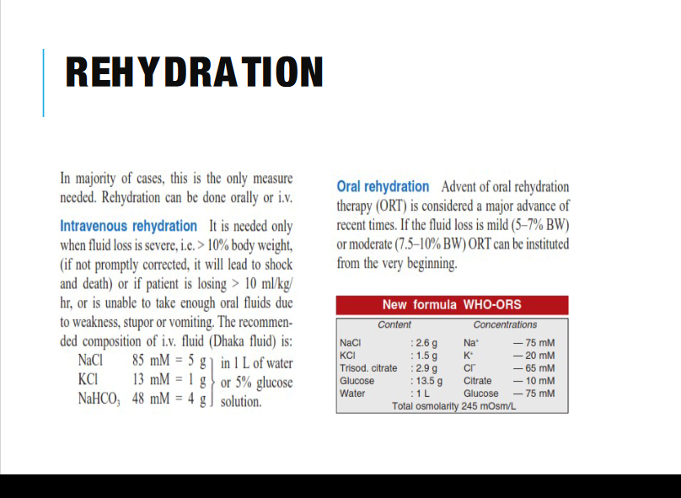
REHYDRATION

Slide 14
ORAL REHYDRATION THERAPY
ORT restores and maintains hydration, electrolyte and pH balance and is life saving in most cases.
ORT-with Nacl, Glucose and water.
In the ileum, glucose enhances absorption of Na and water follows.
Does not correct diarrhoea.
ORT- fluid loss of >5-10% BW.
I.V rehydration- fluid loss >10%BW or losing >10 ml/kg/hr.

Slide 15
Non-diarrhoeal uses of ORT
Post-surgical, post-burn, post-trauma
Rehydration and nutrition
Heat stroke
To change from parenteral to oral route

Slide 16
NUTRITION
Contrary to traditional view, patients of diarrhoea should not be starved.
Fasting decreases brush border disaccharidase enzymes and reduces absorption of salt, water and nutrients; may lead to malnutrition if diarrhoea is prolonged or recurrent.
Feeding during diarrhoea has been shown to increase intestinal digestive enzymes and cell proliferation in mucosa.
Simple foods like breast milk, boiled potato, rice, chicken soup, banana etc. should be given as soon as the patient can eat.

Slide 17
DRUG THERAPY
Drugs used in diarrhoeas may be categorised into:
1. Specific antimicrobial drugs
2. Probiotics
3. Drugs for inflammatory bowel disease (IBD)
4. Nonspecific antidiarrhoeal drugs

Slide 18
ANTIMICROBIALS IN DIARRHOEA
One or more antimicrobial agent is almost routinely prescribed to most patients of diarrhoea.
However, such drugs have a limited role in the overall treatment of diarrhoeal diseases; the reasons are:
Bacterial pathogen is responsible for only a fraction of cases.
Even in bacterial diarrhoea, antimicrobials alter the course of illness only in selected cases.
Antimicrobials may prolong the carrier state

Slide 19
ANTIMICROBIALS IN DIARRHOEA
A. Antimicrobials are of no value In diarrhoea due to noninfective causes, such as: (i) Irritable bowel syndrome (IBS) (ii) Coeliac disease (iii) Pancreatic enzyme deficiency
B. Antimicrobials are useful only in severe disease (but not in mild cases):(i) Travellers' diarrhoea: mostly due to ETEC, Campylobacter or virus: Cotrimoxazole, Norfloxacin, Doxycycline reduce the duration of diarrhoea and total fluid needed only in severe cases.

Slide 20
ANTIMICROBIALS IN DIARRHOEA
C. Antimicrobials are regularly useful in:
(i) Cholera
(ii) Campylobacter jejuni
(iii) Clostridium difficile (iv) Diarrhoea associated with bacterial growth (v) Amoebiasis (vi) Giardiasis

Slide 21
PROBIOTICS IN DIARRHOEA
These are microbial cell preparations, either live cultures or lyophillised powders
They are intended to restore and maintain healthy gut flora or have other health benefits.
Diarrhoeal illnesses and antibiotic use are associated with alteration in the population, composition and balance of gut microflora.
Recolonization of the gut by non-pathogenic, mostly lactic acid forming bacteria and yeast is believed to help restore this balance.
Organisms most commonly used are— Lactobacillus sp., Bifidobacterium, Streptococcus faecalis, Enterococcus sp. and the yeast Saccharomyces boulardii, etc

Slide 22
DRUGS FOR (IBD)
IBD is a chronic relapsing inflammatory disease of the ileum, colon, or both, that may be associated with systemic manifestations.
It is idiopathic, but appears to have an important immune component triggered by a variety of factors.
The two major types of IBD are ulcerative colitis (UC) and Crohn’s disease (CrD).
Drugs used in IBD can be grouped into:
5-Amino salicylic acid (5-ASA) compounds
Corticosteroids
Immunosuppressants
TNFa inhibitors

Slide 23
5-ASA COMPOUNDS
Sulfasalazine It is a compound of 5-ASA compounds with sulfapyridine linked through an azo bond, and has a specific therapeutic effect in IBD.
It is poorly absorbed from the ileum.
The azo bond is split by colonic bacteria to release 5-ASA and sulfapyridine. The former exerts a local antiinflammatory effect, the mechanism of which is not clear.
It inhibits both COX and LOX, decreased PG and LT production important.

Slide 24
5-ASA COMPOUNDS
SIDE EFFECT:
Rashes, fever,
Joint pain,
Haemolysis and blood dyscrasias.
Up to 1/3rd patients suffer intolerable adverse effects.
Oligospermia and male infertility

Slide 25
IMMUNOSUPPRESSANTS
Immunosuppressants have now come to play an important role in the long-term management of IBD.
About 60% patients with CrD and substantial number of UC patients require immunosuppressive therapy.
However, risks of chronic immunosuppression must be weighed in each patient before instituting therapy with these drugs.
Azothioprine
Methotrexate
cyclosporine

Slide 26
TNF INHIBITORS
Infliximab It is chimeric anti-TNFa antibody that is indicated in severe active CrD, fistulating CrD and severe UC
Therapy is continued till response is maintained.
Infliximab produces substantial toxicity including acute reactions, formation of antibodies and lowering of resistance to infections.
Thus, it is only a reserve drug for selected patients with refractory disease.
Adalimumab and some other TNFa inhibitors are also being used in severe and refractory IBD.

Slide 27
CORTICOSTEROIDS
Prednisolone (40–60 mg/day) or equivalent are highly effective in controlling symptoms as well as in inducing remission in both UC and CrD.
They are the drugs of choice for moderately severe exacerbations.
In responsive patients symptomatic relief usually starts within 3– 7 days and remission is induced in 2–3 weeks.
In more severe disease with extra intestinal manifestations and for rapid relief therapy may be initiated with i.v. methyl prednisolone 40–60 mg 12 to 24 hourly for few days.

Slide 28
ABSORBANTS
These are colloidal bulk forming substances like ispaghula, methyl cellulose, carboxy methyl cellulose which absorb water and swell.
They modify the consistency and frequency of stools and give an impression of improvement, but do not reduce the water and electrolyte loss.
They are of value in selected conditions like diarrhoea phase of IBS, and to increase the consistency of faeces in colostomy patients.
Ispaghula and other bulk forming colloids are useful in both constipation and diarrhoea phases of IBS and reduce abdominal pain as well.
Adsorbants like kaolin, pectin, attapulgite are believed to adsorb bacterial toxins in the gut and coat/protect the mucosa.

Slide 29
ANTISECRETORY DRUGS
Racecadotril
This recently introduced pro drug is rapidly converted to thiorphan,
An enkephalinase inhibitor.
It prevents degradation of endogenous enkephalins (ENKs) which are mainly opioid receptor agonists.
Racecadotril decreases intestinal hypersecretion, without affecting motility (motility appears to be regulated through µ receptors) by lowering mucosal cAMP due to enhanced ENK action.

Slide 30
ANTISECRETORY DRUGS
Bismuth subsalicylate:
Taken as suspension (60 ml 6 hourly) it is thought to act by decreasing PG synthesis in the intestinal mucosa, thereby reducing Cl secretion.
Anticholinergics:
Atropinic drugs can reduce bowel motility and secretion, but have poor efficacy in secretory diarrhoeas

Slide 31
ANTISECRETORY DRUGS
Octreotide:
This somatostatin analogue ha s a long plasma t½ (90 min) as well as potent antisecretory/ antimotility action on the gut.
Opoids:
In addition to their well recognized antimotility action, opioids reduce intestinal secretion. Loperamide has been clearly shown to reduce secretion, probably through specific opioid receptors, but does not affect mucosal cAMP or cGMP levels. .

Slide 32
ANTIMOTILITY DRUGS
These are opioid drugs which increase small bowel tone and segmenting activity, reduce propulsive movements and diminish intestinal secretions while enhancing absorption.
The ∂ receptors --promote absorption and inhibit secretion.
The µ receptors --absorption and decrease propulsive movements.

Slide 33
ANTIMOTILITY DRUGS
Codeine This o pium alkaloid has prominent constipating action at a dose of 60 mg TDS.
The antidiarrheal effect is attributed primarily to its peripheral action on small intestine and colon.
It does have central effects.
Side effects are nausea, vomiting and dizziness

Slide 34
ANTIMOTILITY DRUGS
DIPHENOXYLATE (2.5mg) +ATROPINE (0.025mg)
It is a synthetic opioid, chemically related to pethidine pharmacologically similar to codeine.
The antidiarrheal action is most prominent, but because it is absorbed systemically and crosses blood-brain barrier—CNS effects do occur.
Atropine is added in sub-pharmacological dose to discourage abuse by taking several tablets.
It has caused respiratory depression, paralytic ileus and toxic megacolon in children.

Slide 35
ANTIMOTILITY DRUGS
LOPERAMIDE
It is an opiate analogue with major peripheral µ opioid and additional weak anticholinergic property.
As a constipating agent it is much more potent than codeine. 
Entry into brain is negligible—CNS effects are rare and occur only with high doses;
No abuse liability.
The duration of action is longer (12 hr) than codeine and diphenoxylate

Slide 36
LOPERAMIDE
Adverse effects
Abdominal cramps and rashes are the most common side effects.
Paralytic ileus, toxic mega colon with abdominal distension is a serious complication in young children— fatalities have occurred, probably due to absorption of toxins from the intestines.
Loperamide is contraindicated in children < 4 yr.
However, it appears to be the most effective and most suitable of the antimotility antidiarrheal drugs.

Slide 37
SUMMARY
In diarrhoea there is increase in motility and secretions in the gut with ↓ absorption of water and electrolytes.
Approaches in treatment of diarrhoea:
1. Replacement of fluid and electrolytes.
2. Treatment of the cause.
3. Anti diarrhoeal agents

Slide 38
Questions?

Slide 39

.

